Slide 1

ProJect:
KidsGao(clone)

Slide 2
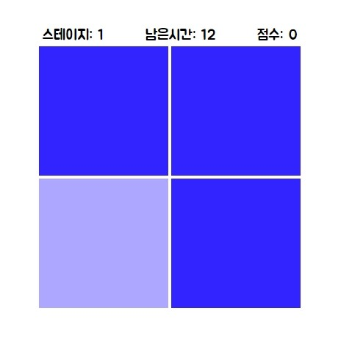
ProJect:
DiffColorCatch
(clone)

